Slide 1
EXCEPTION HANDLING IN JAVA

Slide 2
WHAT IS AN EXCEPTION?
Dictionary Meaning: Exception is an abnormal condition.
An Exception is an unwanted event that interrupts the normal flow of the program.
When an exception occurs program execution gets terminated. In such cases we get a system generated error message.
The good thing about exceptions is that they can be handled in Java.
By handling the exceptions we can provide a meaningful message to the user about the issue rather than a system generated message, which may not be understandable to a user.

Slide 3
WHAT IS AN EXCEPTION?
Exceptions are events that occur during the execution of programs that disrupt the normal flow of instructions (e.g. divide by zero, array access out of bound, etc.).
In Java, an exception is an object that wraps an error event that occurred within a method and contains:
Information about the error including its type
The state of the program when the error occurred
Optionally, other custom information
Exception objects can be thrown and caught.

Slide 4
TYPES OF ERRORS
There are two types of errors:
Compile time errors
Runtime errors
Compile time errors can be again classified again into two types:
Syntax Errors
Semantic Errors : Forgetting to divide by 100 when printing a percentage amount.

Slide 5
EXCEPTION HANDLING
We have two choices when an exception object is created in our application.
Either we will handle it within method
Or we can pass it to the caller method to let it handle.
This is very important decision to be made while setting the responsibilities of a method. A method should clearly indicate that what all exceptional scenarios it will handle and which it will not. It is defined in method syntax using throws clause.
To handle the exception, We must catch the exception in catch section of try-catch block.
If an exception is not handled in the application, then it will propagate to JVM and JVM will usually terminate the program itself.

Slide 6
EXCEPTION HANDLING
If an exception occurs, which has not been handled by programmer then program execution gets terminated and a system generated error message is shown to the user. For example look at the system generated exception below:
An exception generated by the system is given below
Exception in thread "main" java.lang.ArithmeticException: / by zero at ExceptionDemo.main(ExceptionDemo.java:5)
ExceptionDemo : The class name
main : The method name
ExceptionDemo.java : The filename
java:5 : Line number
This message is not user friendly so a user will not be able to understand what went wrong. In order to let them know the reason in simple language, we handle exceptions.
We handle such conditions and then prints a user friendly warning message to user, which lets them correct the error as most of the time exception occurs due to bad data provided by user.

Slide 7
ADVANTAGE OF EXCEPTION HANDLING
Exception handling ensures that the flow of the program doesn’t break when an exception occurs. For example, if a program has bunch of statements and an exception occurs mid way after executing certain statements then the statements after the exception will not execute and the program will terminate abruptly.
By handling we make sure that all the statements execute and the flow of program doesn’t break.

Slide 8
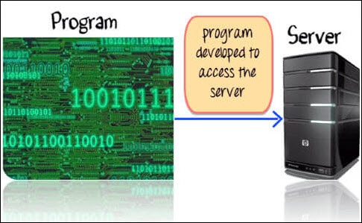
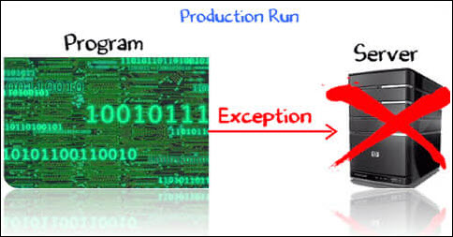
Suppose you have coded a program to access the server. Things worked fine while you were developing the code.
During the actual production run, the server is down. When your program tried to access it, an exception is raised.

Slide 9
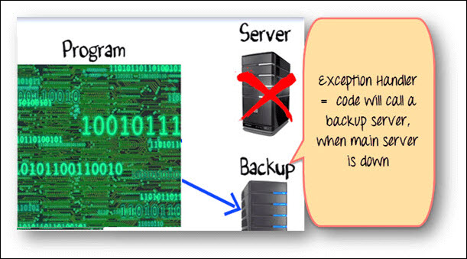
How to Handle Exception
So far we have seen, exception is beyond developer's control. But blaming your code failure on environmental issues is not a solution. You need a Robust Programming, which takes care of exceptional situations. Such code is known as Exception Handler.
In our example, good exception handling would be, when the server is down, connect to the backup server.
To implement this, enter your code to connect to the server (Using traditional if and else conditions).
You will check if the server is down. If yes, write the code to connect to the backup server.

Slide 10
Such organization of code, using "if" and "else" loop is not effective when your code has multiple java exceptions to handle.
class connect
{
if(Server Up)
{
// code to connect to server
}
else
{
// code to connect to BACKUP server
}
}

Slide 11
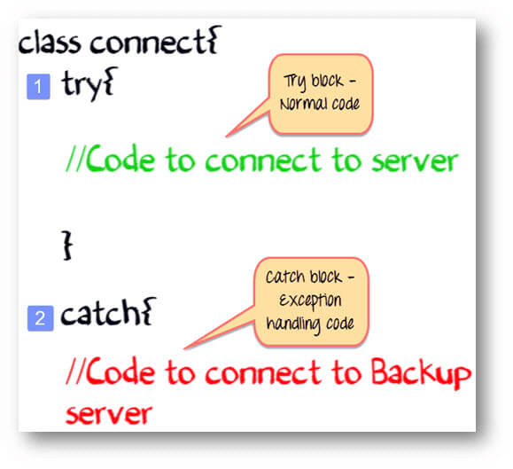
TRY CATCH BLOCK
Java provides an inbuilt exceptional handling.
The normal code goes into a TRY block.
The exception handling code goes into the CATCH block

Slide 12
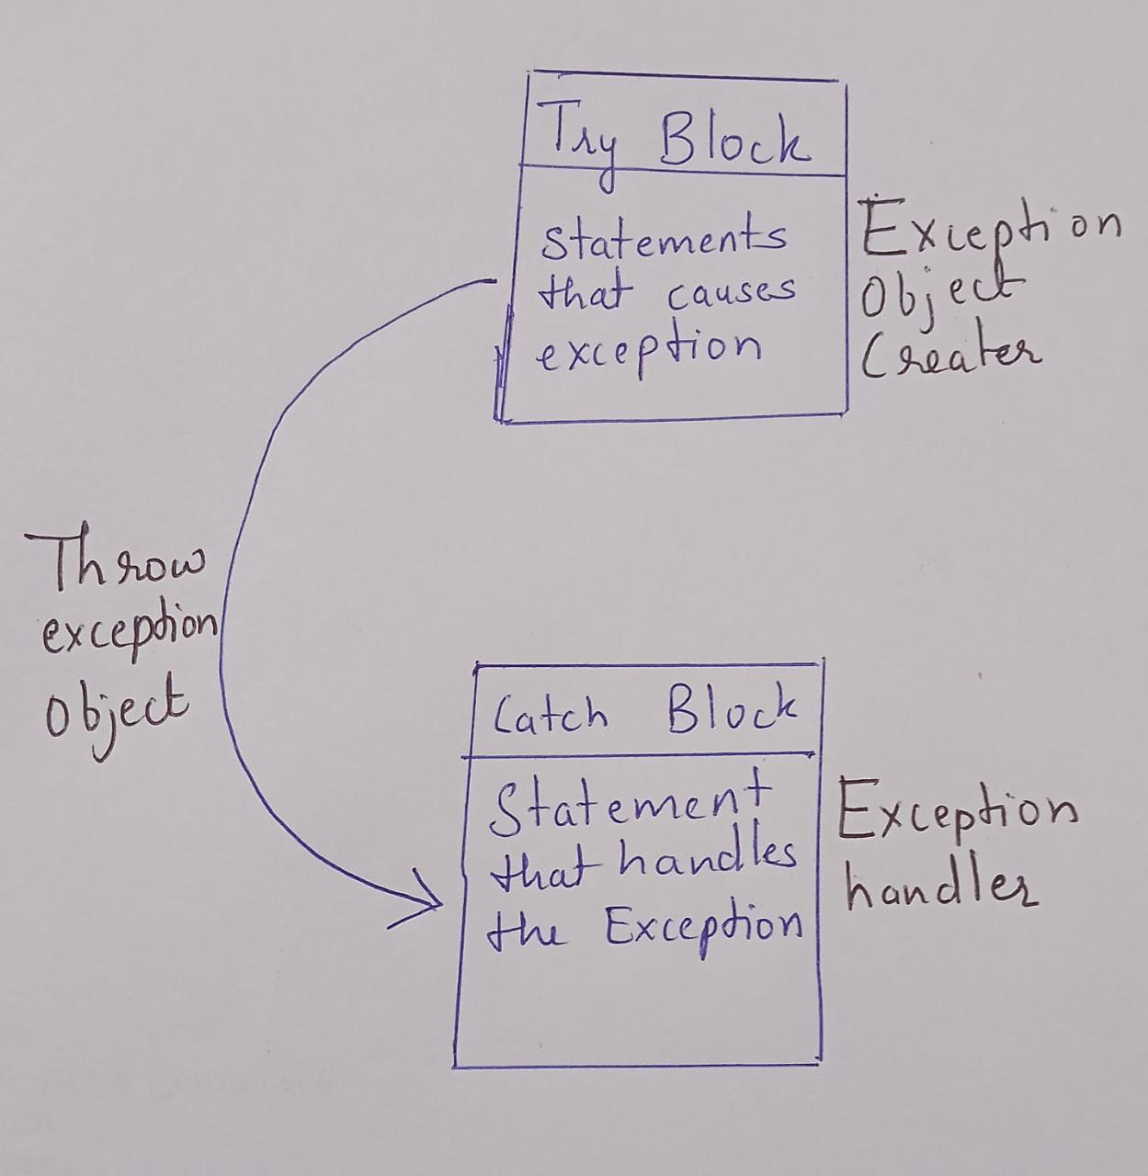
TASKS OF EXCEPTION HANDLING
Hit the exception (find the problem)
Throw the exception (inform that an error has occurred)
Catch the exception (receive the error information)
Handle the exception (take corrective action)

Slide 13
SYNTAX FOR USING TRY & CATCH
Try
{
statement(s)
}
catch (exceptiontype name)
{
statement(s)
}

Slide 14
class JavaException
{
public static void main(String args[])
{
int d = 0;
int n = 20;
try
{
int fraction = n / d;
System.out.println("This line will not be Executed");
}
catch (ArithmeticException e)
{
System.out.println("In the catch Block due to Exception = " + e);
}
System.out.println("End Of Main");
}
}
class JavaException
{
public static void main(String args[])
{
int d = 0;
int n = 20;
int fraction = n/d;
System.out.println("End Of Main");
}
}
Note: The AritmeticException Object "e" carries information about the exception that has occurred which can be useful in taking recovery actions.

Slide 15
TYPES OF EXCEPTIONS
There are two types of exceptions in Java:
1)Checked exceptions
2)Unchecked exceptions
Checked exceptions
All exceptions other than Runtime Exceptions are known as Checked exceptions as the compiler checks them during compilation to see whether the programmer has handled them or not. If these exceptions are not handled/declared in the program, you will get compilation error. For example, SQLException, IOException, ClassNotFoundException etc.
Unchecked Exceptions
Runtime Exceptions are also known as Unchecked Exceptions. These exceptions are not checked at compile-time so compiler does not check whether the programmer has handled them or not but it’s the responsibility of the programmer to handle these exceptions and provide a safe exit. For example, ArithmeticException, NullPointerException, ArrayIndexOutOfBoundsException etc.
Compiler will never force you to catch such exception or force you to declare it in the method using throws keyword.

Slide 16
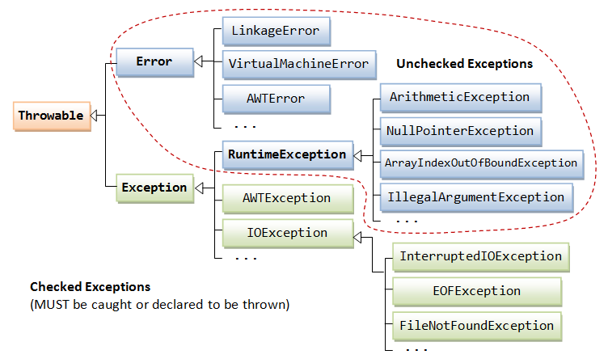

Slide 17
JAVA EXCEPTION KEYWORDS
There are 5 keywords which are used in handling exceptions in Java.
Keyword | Description
try | The "try" keyword is used to specify a block where we should place exception code. The try block must be followed by either catch or finally. It means, we can't use try block alone.
catch | The "catch" block is used to handle the exception. It must be preceded by try block which means we can't use catch block alone. It can be followed by finally block later.
finally | The "finally" block is used to execute the important code of the program. It is executed whether an exception is handled or not.
throw | The "throw" keyword is used to throw an exception.
throws | The "throws" keyword is used to declare exceptions. It doesn't throw an exception. It specifies that there may occur an exception in the method. It is always used with method signature.

Slide 18
MULTIPLE CATCH BLOCKS IN JAVA
class Example2
{
public static void main(String args[])
{
try
{
int a[]=new int[7];
a[8]=30/0;
System.out.println("First print statement in try block");
}
catch(ArithmeticException e){
System.out.println("Warning: ArithmeticException");
}
catch(ArrayIndexOutOfBoundsException e){
System.out.println("Warning: ArrayIndexOutOfBoundsException");
}
catch(Exception e){
System.out.println("Warning: Some Other exception");
}
System.out.println("Out of try-catch block...");
}
Output:
Warning: ArithmeticException
Out of try-catch block...

Slide 19
class Example
{
public static void main(String args[])
{
try{
int arr[]=new int[7];
arr[10]=10/5;
System.out.println("Last Statement of try block");
}
catch(ArithmeticException e){
System.out.println("You should not divide a number by zero");
}
catch(ArrayIndexOutOfBoundsException e){
System.out.println("Accessing array elements outside of the limit");
}
catch(Exception e){
System.out.println("Some Other Exception");
}
System.out.println("Out of the try-catch block");
}
}
Output:
Accessing array elements outside of the limit Out of the try-catch block

Slide 20
class Example
{
public static void main(String args[]){
try
{
int arr[]=new int[7];
arr[10]=10/5;
System.out.println("Last Statement of try block");
}
catch(Exception e){
System.out.println("Some Other Exception");
}
catch(ArithmeticException e){
System.out.println("You should not divide a number by zero");
}
catch(ArrayIndexOutOfBoundsException e){
System.out.println("Accessing array elements outside of the limit");
}
System.out.println("Out of the try-catch block");
}
}
Why we got this error?
This is because we placed the generic exception catch block at the first place which means that none of the catch blocks placed after this block is reachable. You should always place this block at the end of all other specific exception catch blocks.
/Example.java:11: error: exception ArithmeticException has already been caught catch(ArithmeticException e){ ^
/Example.java:14: error: exception ArrayIndexOutOfBoundsException has already been caught catch(ArrayIndexOutOfBoundsException e){ ^ 2 errors

Slide 21
NESTED TRY CATCH BLOCK IN JAVA
Syntax:
....
try
{
statement 1;
statement 2;
try
{
statement 1;
statement 2;
}
catch(Exception e)
{
}
}
catch(Exception e)
{
}
....
When a try catch block is present in another try block then it is called the nested try catch block. Each time a try block does not have a catch handler for a particular exception, then the catch blocks of parent try block are inspected for that exception, if match is found that that catch block executes.
If neither catch block nor parent catch block handles exception then the system generated message would be shown for the exception,

Slide 22
public class Excep6
{
public static void main(String args[])
{
try
{
try
{
System.out.println("going to divide");
int b =39/0;
}
catch(ArithmeticException e)
{ System.out.println(e); }
int x=5/0;
try
{
int a[]=new int[5];
a[5]=4;
}
catch(ArrayIndexOutOfBoundsException e)
{ System.out.println(e); }
System.out.println("other statement");
}
catch(Exception e)
{ System.out.println("handeled");}
System.out.println("normal flow..");
}
}
going to dividejava.lang.ArithmeticException: / by zero
java.lang.ArrayIndexOutOfBoundsException: Index 5 out of bounds for length 5
other statement
normal flow..

Slide 23
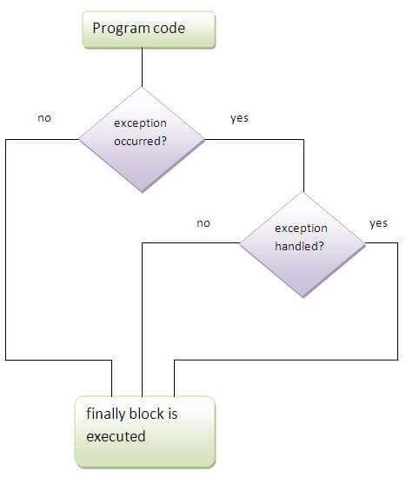
JAVA FINALLY BLOCK
A finally block contains all the crucial statements that must be executed whether exception occurs or not. The statements present in this block will always execute regardless of whether exception occurs in try block or not such as closing a connection, stream etc.
Syntax of Finally block
try
{
//Statements that may cause an exception
}
catch
{
//Handling exception
}
finally
{
//Statements to be executed
}

Slide 24
class Example
{
public static void main(String args[])
{
try
{
int num=121/0;
System.out.println(num);
}
catch(ArithmeticException e)
{
System.out.println("Number should not be divided by zero");
}
/* Finally block will always execute even if there is no exception in try block */
finally
{
System.out.println("This is finally block");
}
System.out.println("Out of try-catch-finally");
}
}
Output:
Number should not be divided by zero
This is finally block
Out of try-catch-finally

Slide 25
class JavaFinally
{
public static void main(String args[])
{
System.out.println(JavaFinally.myMethod());
}
public static int myMethod()
{
try
{
return 112;
}
finally
{
System.out.println("This is Finally block");
System.out.println("Finally block ran even after return statement");
}
}
}
Output of above program:
This is Finally block
Finally block ran even after return statement
112
You can see that even though we have return statement in the method, the finally block still runs.

Slide 26
FINALLY BLOCK AND SYSTEM.EXIT()
System.exit() statement behaves differently than return statement. Unlike return statement whenever System.exit() gets called in try block then Finally block doesn’t execute. Here is a code snippet that demonstrate the same:
....
try {
//try block
System.out.println("Inside try block");
System.exit(0)
}
catch (Exception exp) {
System.out.println(exp);
}
finally {
System.out.println("Java finally block");
}
....

Slide 27
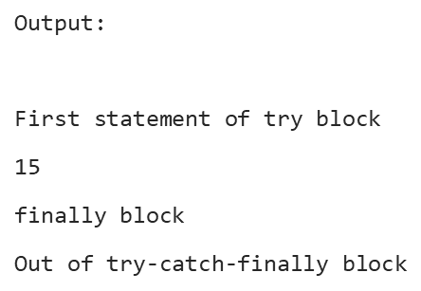
Example 1: The following example demonstrate the working of finally block when no exception occurs in try block
class Example1
{
public static void main(String args[])
{
try
{
System.out.println("First statement of try block");
int num=45/3;
System.out.println(num);
}
catch(ArrayIndexOutOfBoundsException e)
{
System.out.println("ArrayIndexOutOfBoundsException");
}
finally
{
System.out.println("finally block");
}
System.out.println("Out of try-catch-finally block")
}}

Slide 28
Example 2: This example shows the working of finally block when an exception occurs in try block but is not handled in the catch block:
class Example2
{
public static void main(String args[])
{
try
{
System.out.println("First statement of try block");
int num=45/0;
System.out.println(num);
}
catch(ArrayIndexOutOfBoundsException e)
{
System.out.println("ArrayIndexOutOfBoundsException");
}
finally
{
System.out.println("finally block");
}
System.out.println("Out of try-catch-finally block");
}
}
First statement of try block
finally block
Exception in thread "main" java.lang.ArithmeticException: / by zero at Example2.main(Example2.java:8)
Note:
For each try block there can be zero or more catch blocks, but only one finally block.
The finally block will not be executed if program exits(either by calling System.exit() or by causing a fatal error that causes the process to abort).

Slide 29
HOW TO THROW EXCEPTION IN JAVA WITH EXAMPLE
The Java throw keyword is used to explicitly throw an exception.
We can throw either checked or uncheked exception in java by throw keyword. The throw keyword is mainly used to throw custom exception. We will see custom exceptions later.
The syntax of java throw keyword is given below.
throw exception;
Example :
throw new IOException("sorry device error);
class Test
{
public static void main(String args[])
{
System.out.println(10/0);
}
}
Exception in thread "main" java.lang.ArithmeticException: / by zero at Test.main(Test.java:5)
class Test
{
public static void main(String args[])
{
throw new ArithmeticException(“Divide by zero”);
}
}
Exception in thread "main" java.lang.ArithmeticException: Divide by zero at Test.main(Test.java:5)

Slide 30
public class Test
{
public static void main(String args[])
{
throw new ArithmeticException("Divide by zero");
System.out.println("hello");
}
}
/Test.java:6: error: unreachable statement System.out.println("hello")
After throw we cannot write any statement directly.

Slide 31
In this example, we have created the validate method that takes integer value as a parameter. If the age is less than 18, we are throwing the ArithmeticException otherwise print a message welcome to vote.
public class TestThrow1
{
static void validate(int age)
{
if(age<18)
throw new ArithmeticException("not valid");
else
System.out.println("welcome to vote");
}
public static void main(String args[])
{
validate(13);
System.out.println("rest of the code...");
}
}
Output:
Exception in thread "main" java.lang.ArithmeticException: not valid
at TestThrow1.validate(TestThrow1.java:6)
at TestThrow1.main(TestThrow1.java:12)

Slide 32
JAVA THROWS KEYWORD
Throws keyword is used for handling checked exceptions. By using throws we can declare multiple exceptions in one go.
Syntax of java throws
return_type method_name() throws exception_class_name
{
//method code
}

Slide 33
import java.io.*;
public class Test
{
public static void main(String args[])
{
PrintWriter pw=new PrintWriter("abc.txt");
pw.println("Hello");
}
}
/Test.java:6: error: unreported exception FileNotFoundException; must be caught or declared to be thrown PrintWriter pw=new PrintWriter("abc.txt");
1 error
import java.io.*;
public class Test
{
public static void main(String args[]) throws Exception
{
PrintWriter pw=new PrintWriter("abc.txt");
pw.println("Hello");
}
}

Slide 34
import java.io.IOException;
class Testthrows1
{
void m()throws IOException
{
throw new IOException("device error");//checked exception
}
void n()throws IOException
{
m();
}
void p()
{
try
{
n();
}
catch(Exception e)
{ System.out.println("exception handled"); }
}
public static void main(String args[])
{
Testthrows1 obj=new Testthrows1();
obj.p();
System.out.println("normal flow of execution...");
}
}
.
exception handled
normal flow of execution...

Slide 35
Difference between throw and throws
throw | throws
throw keyword is used to throw an exception explicitly. | throws keyword is used to declare an exception possible during its execution.
throw keyword is followed by an instance of Throwable class or one of its sub-classes. | throws keyword is followed by one or more Exception class names separated by commas.
throw keyword is declared inside a method body. | throws keyword is used with method signature (method declaration).
We cannot throw multiple exceptions using throw keyword. | We can declare multiple exceptions (separated by commas) using throws keyword.

Slide 36
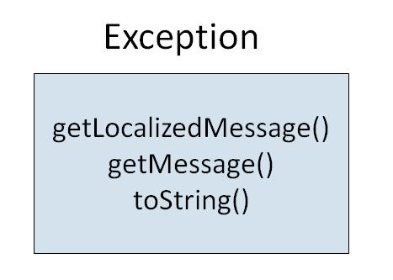
USER DEFINED EXCEPTION IN JAVA
User Defined Exception or custom exception is creating your own exception class and throws that exception using ‘throw’ keyword. This can be done by extending the class Exception.
There is no need to override any of the above methods available in the Exception class, in your derived class. But practically, you will require some amount of customizing as per your programming needs.

Slide 37
class MyException extends Exception
{
String str1;
MyException(String str2) {
str1=str2;
}
public String toString(){
return ("MyException Occurred: "+str1) ;
}
}
class Example1
{
public static void main(String args[])
{
try{
System.out.println("Starting of try block");
throw new MyException("This is My error Message");
}
catch(MyException exp){
System.out.println("Catch Block") ;
System.out.println(exp) ;
}
}
}
Starting of try block
Catch Block
MyException Occurred: This is My error Message

Slide 38
class InvalidProductException extends Exception
{
public InvalidProductException(String s){
super(s);
}
}
public class Example1
{
void productCheck(int weight) throws InvalidProductException{
if(weight<100){
throw new InvalidProductException("Product Invalid");
}
}
public static void main(String args[])
{
Example1 obj = new Example1();
try{
obj.productCheck(60);
}
catch (InvalidProductException ex){
System.out.println("Caught the exception");
System.out.println(ex.getMessage());
}
}
}
Caught the exception
Product Invalid

Slide 39
public class Test
{
public static void main(String args[])
{
try
{
System.out.println("outer try block");
try
{
System.out.println("inner try block");
System.out.println(10/0);
}
catch(Exception e)
{
System.out.println("inner catch block");
}
System.out.println("after inner try catch");
}
catch(Exception e)
{
System.out.println("outer catch block");
}
finally
{
System.out.println("outer finally block");
}
}
}

Slide 40
class Main
{
public static void main(String args[])
{
try
{
throw 10;
}
catch(int e)
{
System.out.println("Got the Exception " + e);
}
}
}

Slide 41
class NestedTry
{
public static void main(String args[])
{
try {
int a[] = { 1, 2, 3, 4, 5 };
System.out.println(a[5]);
try {
int x = a[2] / 0;
}
catch (ArithmeticException e2)
{
System.out.println("division by zero is not possible");
}
}
catch (ArrayIndexOutOfBoundsException e1)
{
System.out.println("ArrayIndexOutOfBoundsException");
System.out.println("Element at such index does not exists");
}
} }

Slide 42
class Test
{ int count = 0;
void A() throws Exception
{
try{ count++;
try{ count++;
try{ count++;
throw new Exception();
}
catch(Exception ex)
{ count++;
throw new Exception();
}
}
catch(Exception ex)
{ count++;}
}
catch(Exception ex)
{ count++; }
}
void display()
{
System.out.println(count);
}
public static void main(String[] args) throws Exception
{
Test obj = new Test();
obj.A();
obj.display();
}
}

Slide 43
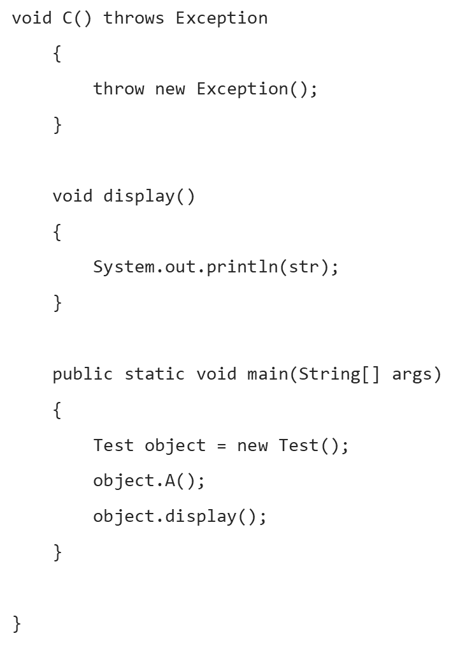
class Test
{
String str = "a";
void A()
{
try
{
str +="b";
B();
}
catch (Exception e)
{
str += "c";
}
}
void B() throws Exception
{
try
{
str += "d";
C();
}
catch(Exception e)
{
throw new Exception();
}
finally
{
str += "e";
}
str += "f";
}

